Slide 1
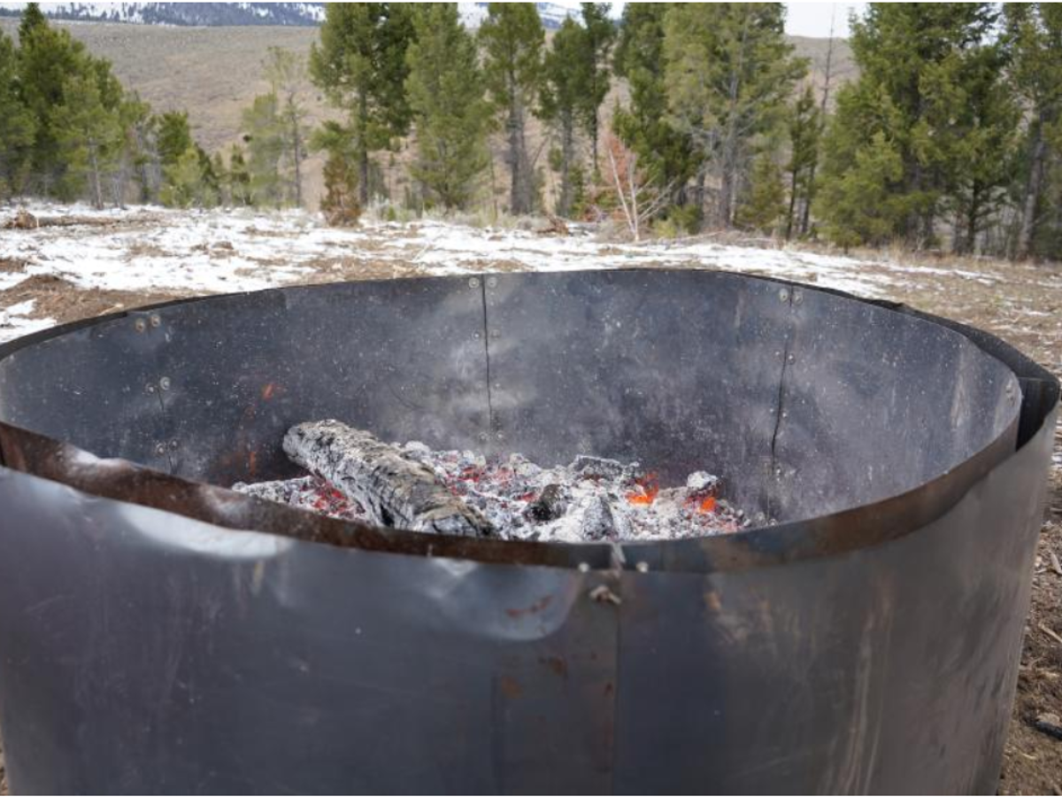
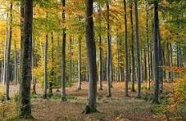

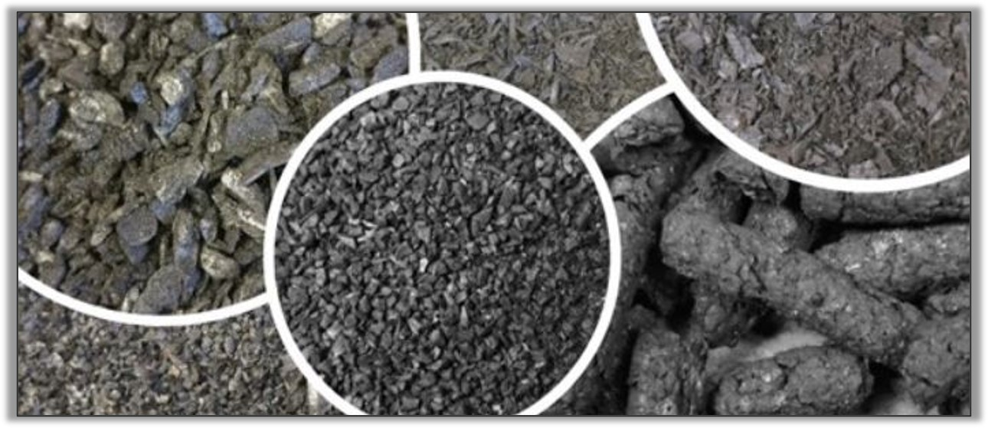
Module 11: Biochar in forestry: From feedstock to application and implications for soil health
Notes:
USDA Forest Service photo by Jessica Brewen

Slide 2
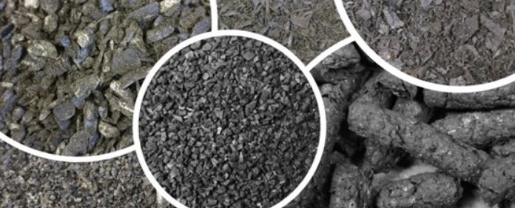
Overview
Biochar—what is it, anyway?
Why is there interest in biochar in forestry?
Production methods
Potential for private woodlands: headwinds and tailwinds.
Cochrane, NRCS
Notes:
Photo: Kristin Trippe, USDA-ARS

Slide 3
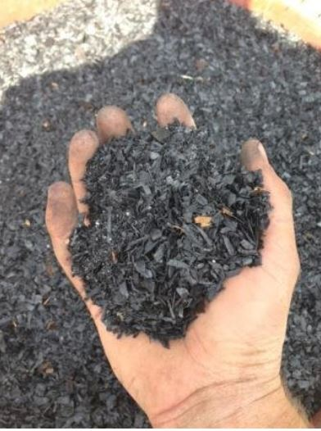
What is biochar?
A solid, carbon-rich material usually produced by Pyrolysis-- the thermochemical decomposition of organic material by heating at temperatures from 300 °C to over 750 °C, in the absence of oxygen.
Charcoal is biochar made from wood, the most common type of biochar. But biochar can also be made from many types of organic materials—bagasse, straw, rice hulls, manure, etc., even biosolids and animal byproducts (offal, feathers, etc.).
Biochar has a low bulk density and contains an abundance of micropores.
Biochar is quite stable in soils and has a high cation exchange capacity (CEC).
Biochar can loosen tight soils and improve water holding capacity.
Biochar applications can increase soil microbial activity.
Remsberg, SARE
Notes:
Some differentiate between char (natural black carbon residues resulting from fire), charcoal (made from woody feedstock primarily as a fuel source), and biochar (made from a variety of organic materials under carefully controlled conditions). For the purposes of this presentation, I refer to all these materials as biochar.

Slide 4
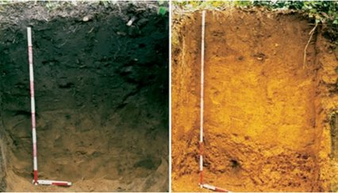

A “proven performer” as a soil amendment for agricultural soils.
”Terra Preta” soils in Amazonia—deep, dark, fertile soils in the midst of a region characterized by Oxisols.
Have been productive for hundreds or thousands of years.
Investigation showed high content of biochar—apparently incorporated intentionally by the indigenous people who lived there.
Why biochar?
Utah State University
Remsberg, SARE
Notes:
While biochar is not a helpful or appropriate amendment for all soils, its benefits for soils like this are indisputable.
Image from Utah State University, courtesy of Glaser, Bruno, Ludwig Haumaier, George Guggenberger and Wolfgang Zech, Semantic Scholar.

Slide 5
Characteristics Important for Soil Health
Biochar is not ash, but it often carries ash with it as a co-product, and typically has a high pH.
Biochar has a high porosity and CEC, but it’s most accessible in finer particle size—particle size vs. surface area.
CEC, stability, inherent fertility, etc. vary according to feedstock and production temperature.
Half life of biochar in soils can vary from decades to millennia, but it is generally quite stable.
Most biochar is a “blank slate” with respect to nutrient content—to be effective as a soil amendment, it usually needs to be “charged.”
Biochar can be an effective amendment to improve the fertility and water holding capacity of soils that have low organic matter, pH, and water holding capacity and to loosen tight or compacted soils.
Remsberg, SARE

Slide 6
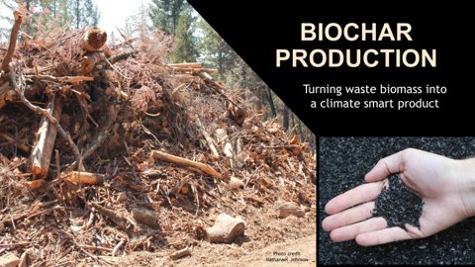
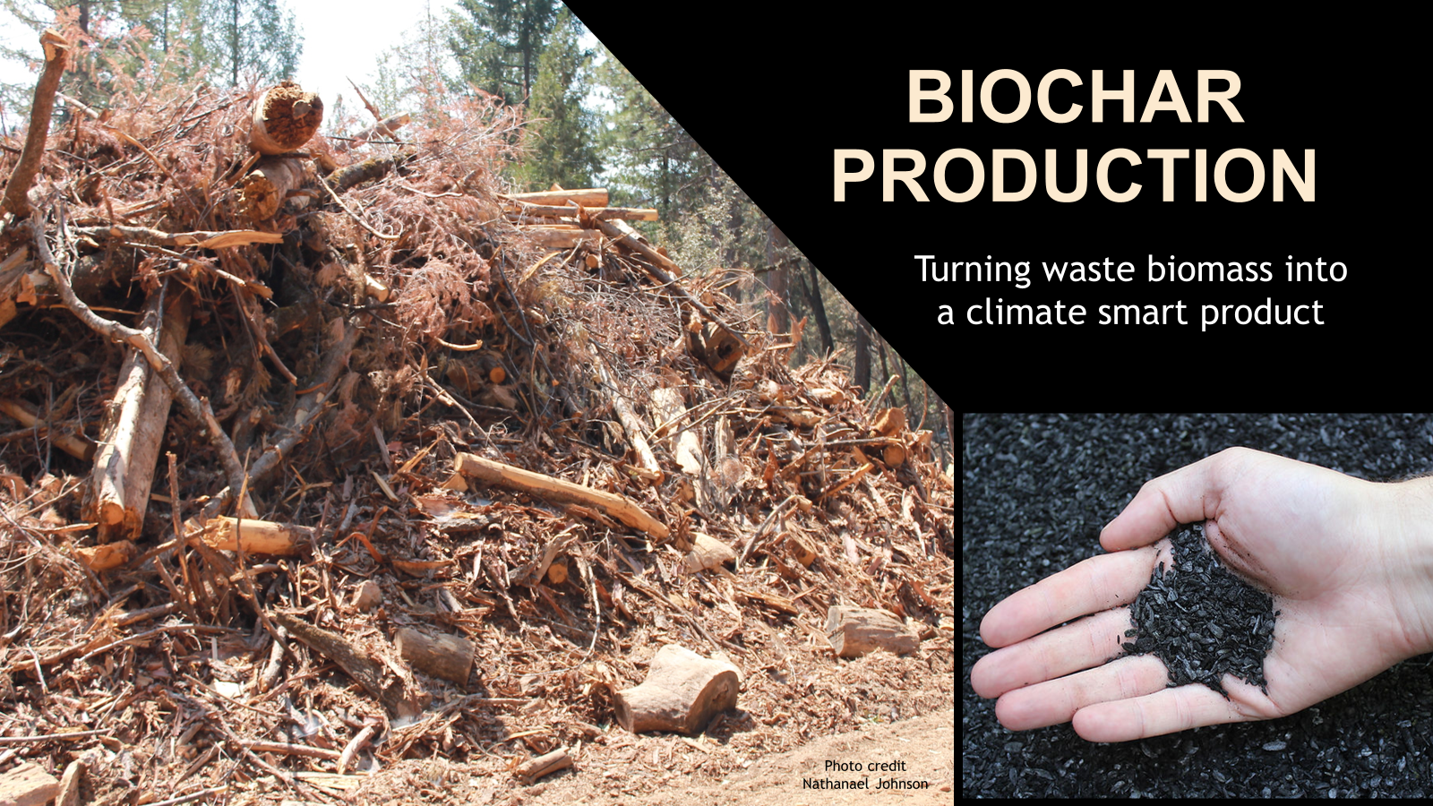
Reduce fire hazard from slash piles.
Clean up woody debris from storm blowdowns.
Reduce CO2 emissions (compared to burning).
Improve soil health, especially for reclamation.
Forestry interest in biochar
Derek Pierson, USFS

Slide 7
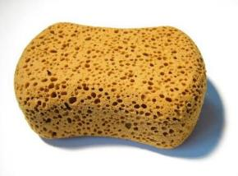
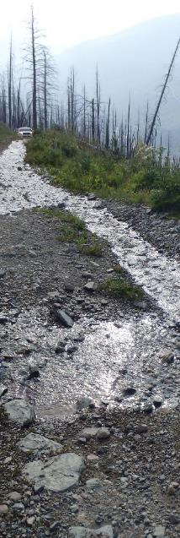
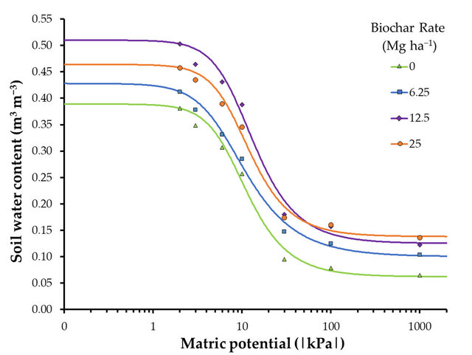
Soil Water Retention
Biochar can:
Decrease overland flow.
Increase infiltration.
Biochar increases available water:
38%: in coarse-textured soil.
19%: in medium-textured soil.
16%: in fine-textured soil.
Lustosa Carvalho, Martha, et al. 2020
Derek Pierson, USFS
Notes:
While an indirect benefit, allowing more water to enter the soil and helping the soil to retain more water corresponds to protecting and enhancing soil organism habitat.

Slide 8
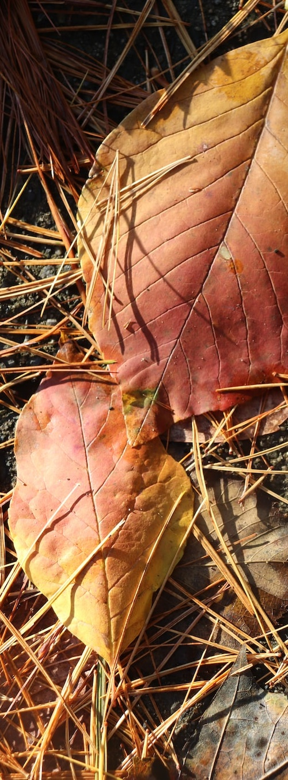
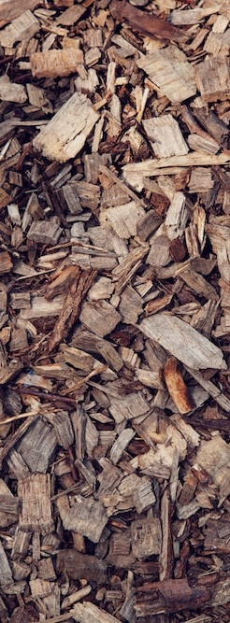
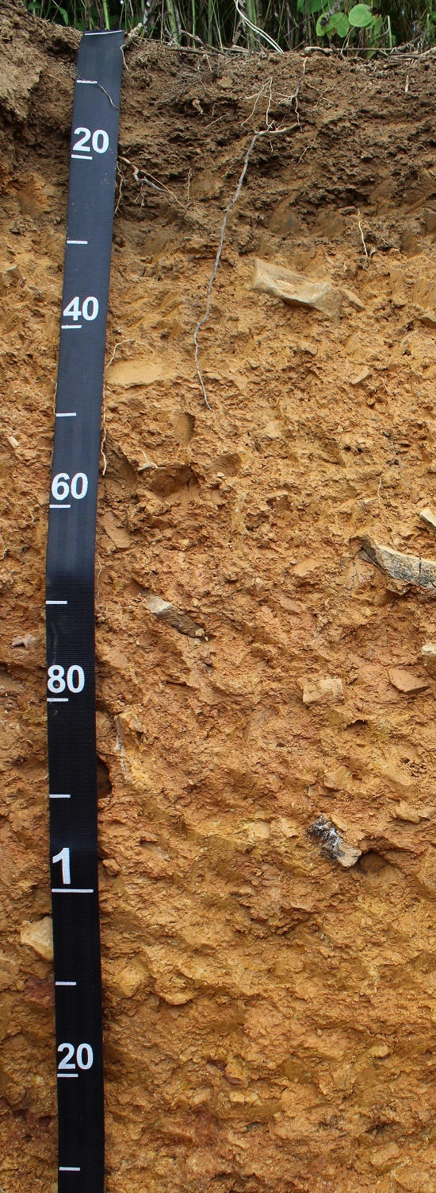
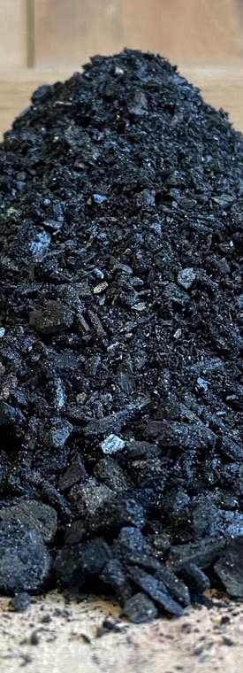
Biochar is distinct with turnover time
(Slide: D. Pierson, USFS)
~ 1 year
10-100 yr
75-200 yr
>300 yr
¹⁴C mean residence time
Notes:
Making biochar = C sequestration
Biochar is far less decomposable than all forms of forest biochar. This stable form of carbon is a direct benefit to our resource concern of OM Depletion.
Basis for C markets
Simply by making the biochar, we’re keeping C out of the atmosphere… for a “relatively” long time
Downstream uses are gravy.

Slide 9
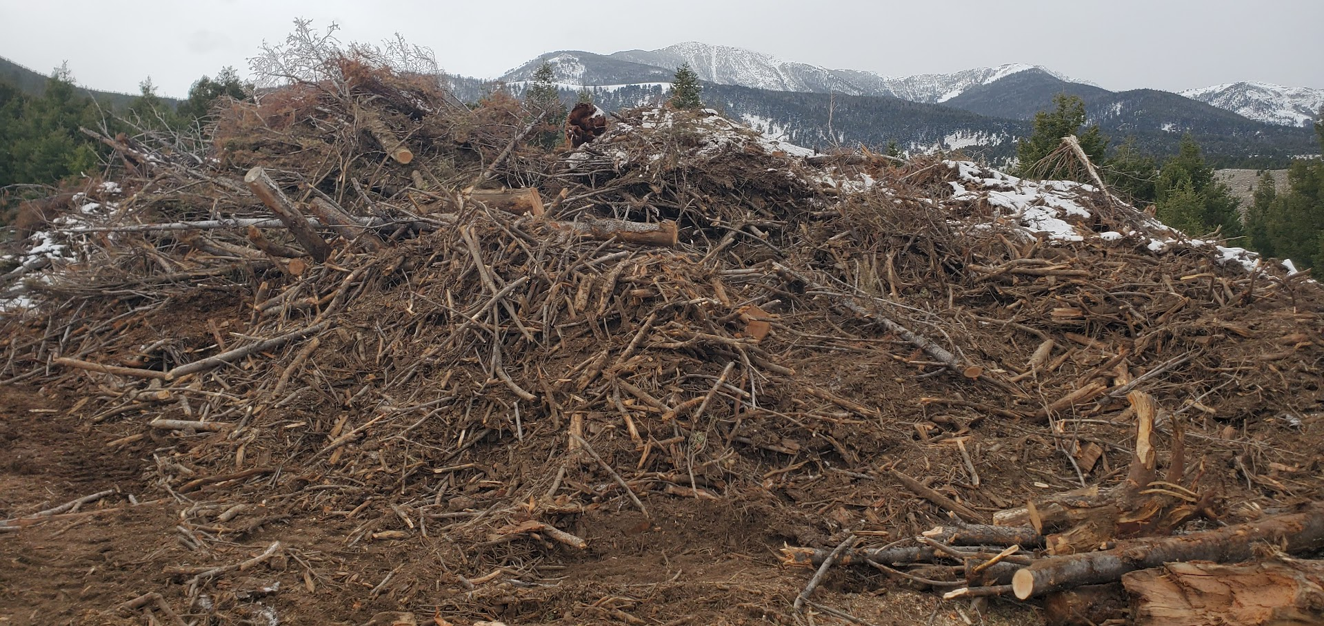
Piles & Piles …
From harvest, fuel treatments, rehabilitation & construction projects etc.
Estimated ~350 million dry tons of forest slash can be produced each year in the US (Bufford & Neary, 2010).
Woody debris from hurricanes, tornadoes, etc.
D. Pierson, USFS

Slide 10
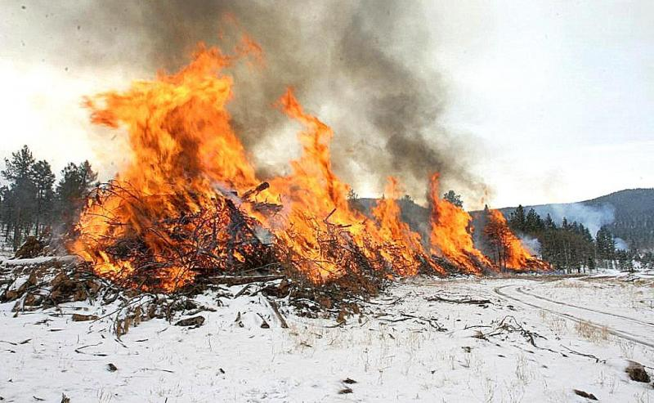
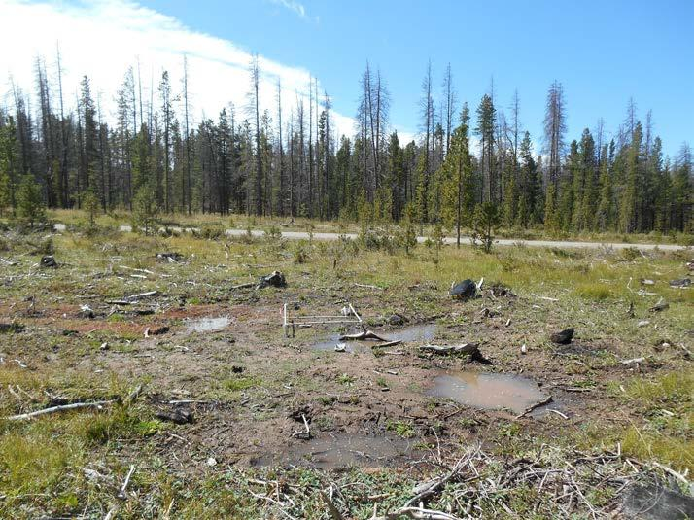
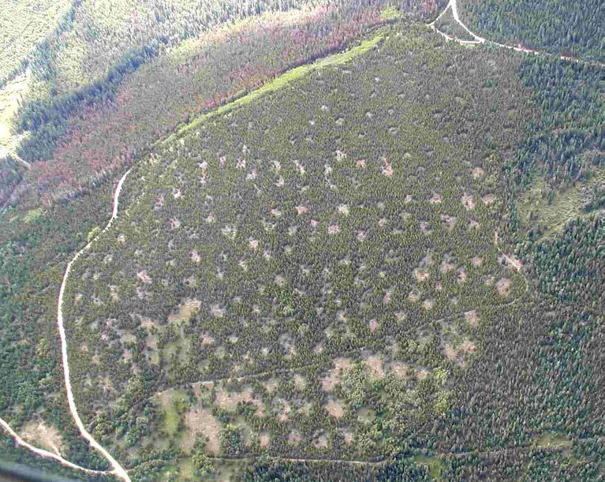
Common Practice: Pile Burning
Slash piles are often burned for disposal:
Loss of OM*
Loss of soil structure*
Legacy of burn scars:
  Few trees or shrubs*
  Invasive species concerns*
Air quality concerns
Release of CO2
Nutrient volatilization
*Issues directly related to SH resource concerns.
Notes:
Slide content courtesy of D. Pierson, USFS

Slide 11
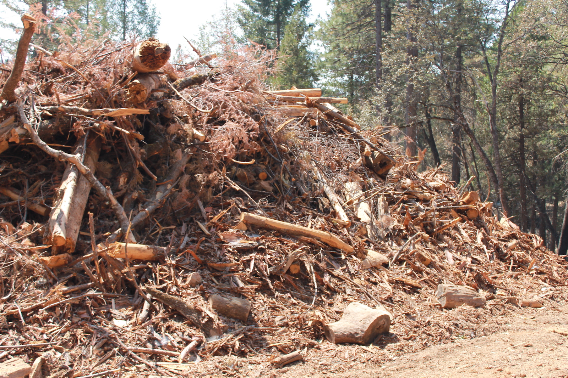
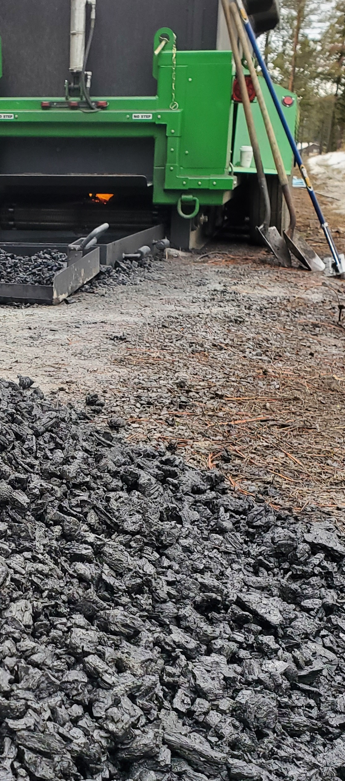
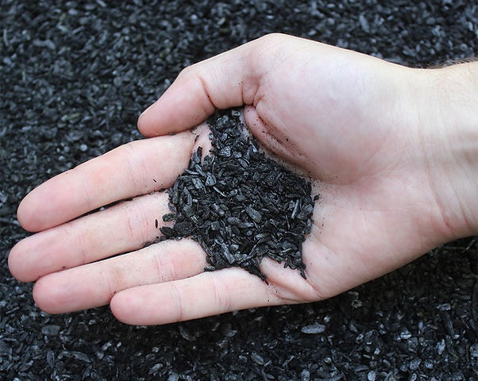
Reduced CO2 Omissions
Kilns process 1-2 ton of forest slash per hour
Burning piles sends most of the biomass C into the atmosphere
Returns ~15% as biochar by mass
~2x higher carbon content than wood
Turning slash into biochar reduces C emissions by
~20-40%
Sequesters ~30% of the slash
carbon
Notes:
Slide content courtesy of D. Pierson, USFS.
“Open Burning of forest and field wastes is the worst method of removal – primarily releases GHG
and soot (with minor recycling of nutrients to soil)”
“Biochar production and use generally releases less GHG than other current waste disposal methods -- and returns valuable organic material to the soil” This relates directly to our SH resource concent “Soil OM Depletion”
Statement credit: Patrick Binns

Slide 12
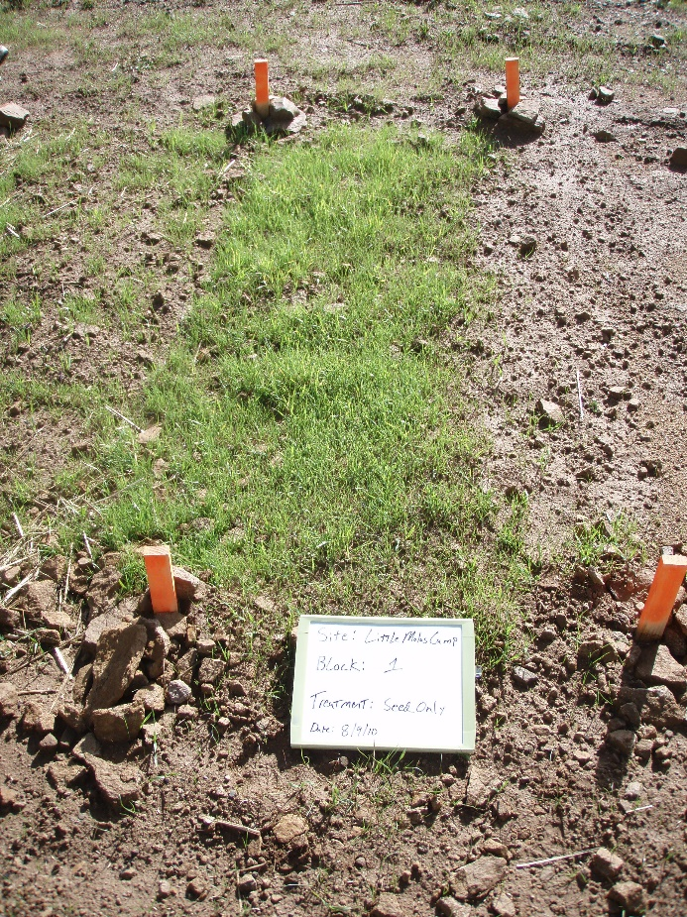
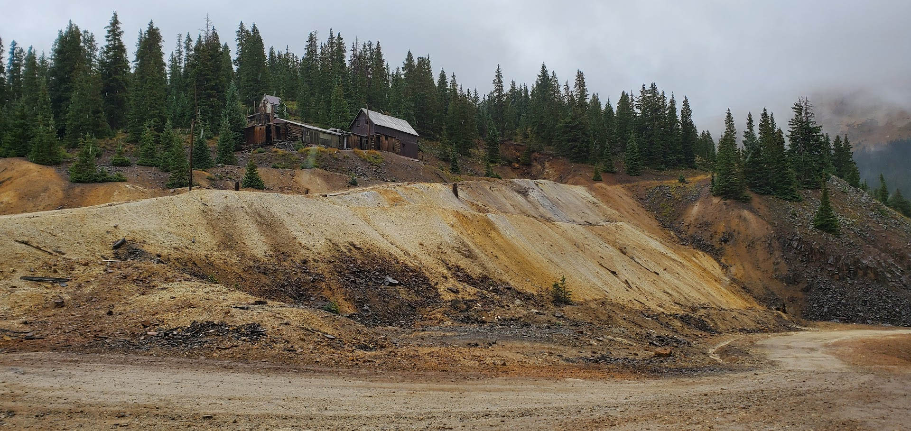
Biochar Applications in Abandoned Mine Lands (AMLs)
Sparse vegetation
Poor soil structure
Acidic soils
Heavy metal contamination
Notes:
Slide content courtesy of D. Pierson, USFS.
These lands aren’t really forestland, but represent a possible place to use biochar that comes from forestlands. Soils on abandoned mine lands and reclaimed quarries/ pits are often compacted, have little organic matter, and provide poor soil organism habitat. Biochar can address all of these resource concerns in many situations.

Slide 13
Identifying suitable sites:
Do we have a good place to use biochar?
Path:
  Define AOI
  Soil Data Explorer
  Suitabilities and Limitations
  Soil Health
  Dynamic Soil Properties Response to Biochar
Web Soil Survey Biochar Interpretation

Slide 14
Factors considered in WSS biochar interpretations
pH
Cation Exchange Capacity
Available Water Holding Capacity
Organic Carbon
Bulk Density
Hydraulic Conductivity

Slide 15
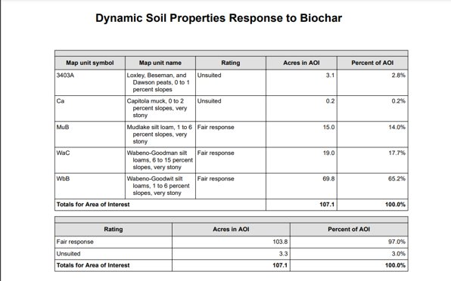
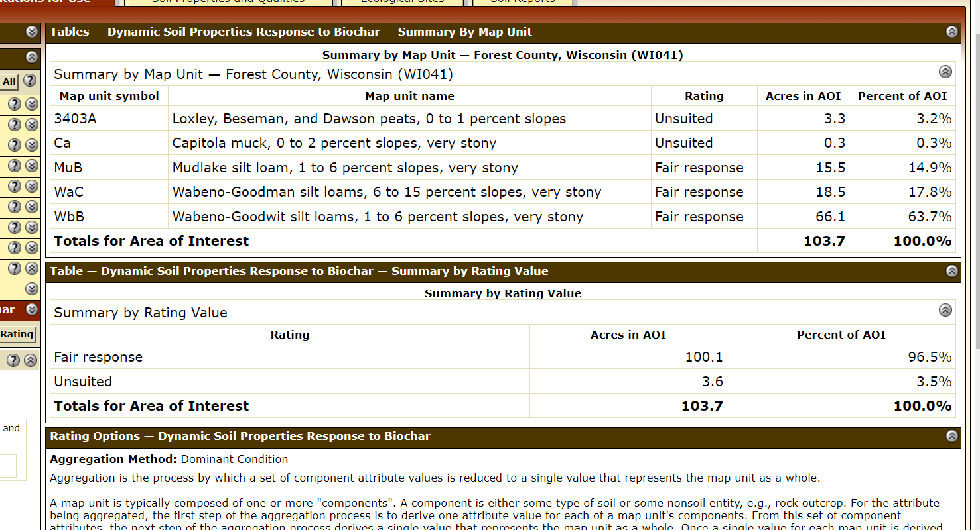
Web Soil Survey Biochar Interpretation Table

Slide 16
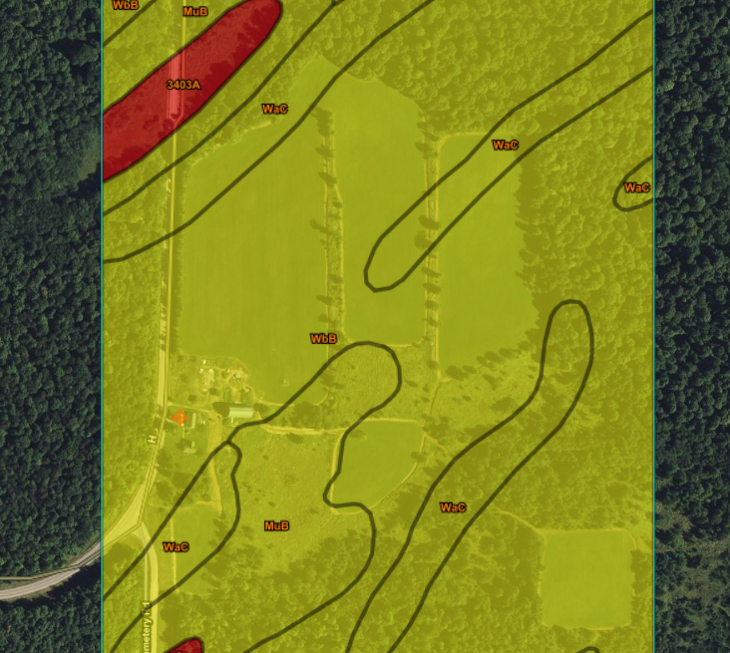
Web Soil Survey interpretation map for biochar–
NE Wisconsin Example

Slide 17
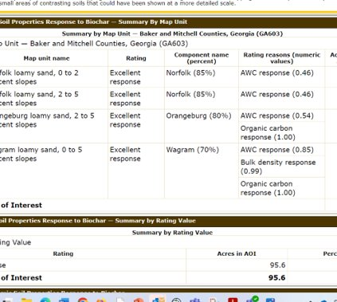
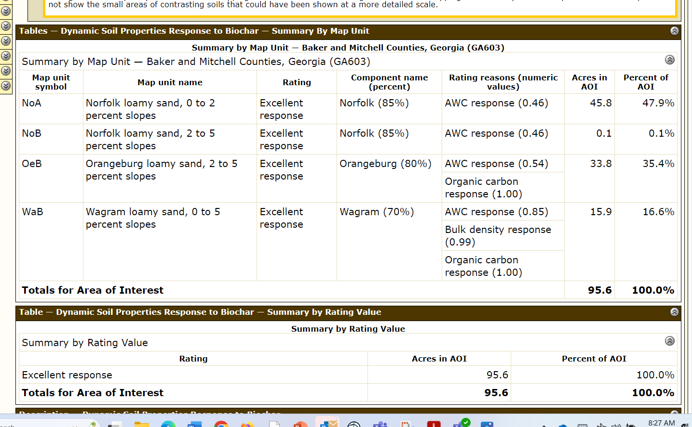
Web Soil Survey interpretation table for biochar—
Example from The Jones Center

Slide 18
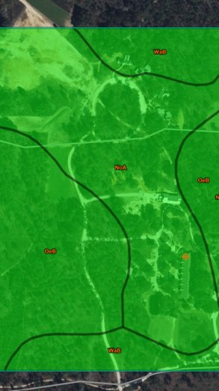
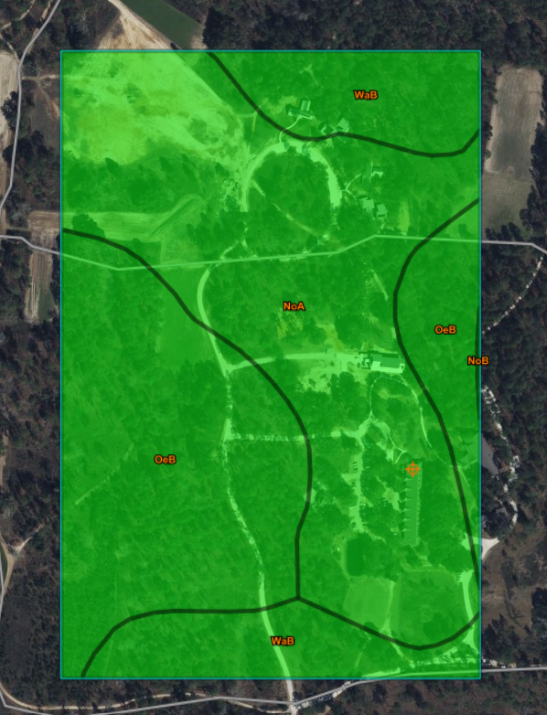
Web Soil Survey interpretation map for biochar-- Example from The Jones Center
Web Soil Survey interpretation map for biochar—
Example from The Jones Center

Slide 19
Biochar Production Methods
Burn in place?
Home-built equipment?
Commercial?
  Conservation burn piles (CBPs)
    Incomplete burning/ drenching of slash piles.
    Crude but effective… somewhat.
  Home built kilns:
    Big Box
  Commercially built burners/kilns
    Ring of Fire ($2,400)
    Carbonator (TigerCat)
    Charboss (< $200K), BurnBoss (<$100K), and several other options (AirBurners)
  All methods need lots of water!

Slide 20
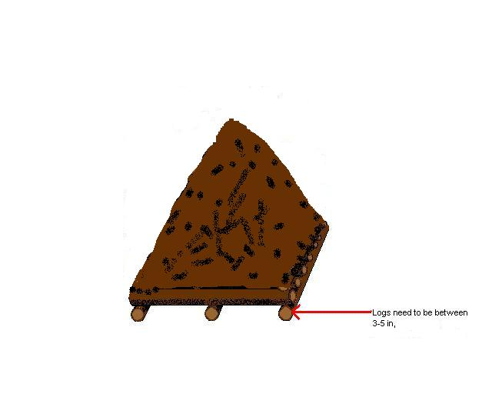
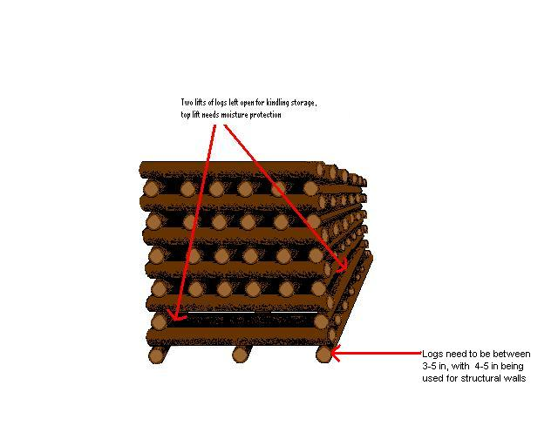
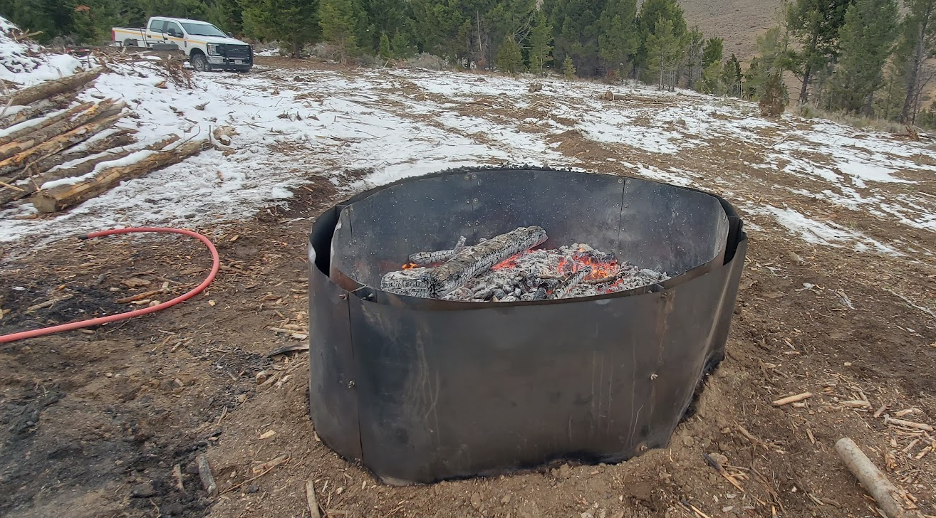
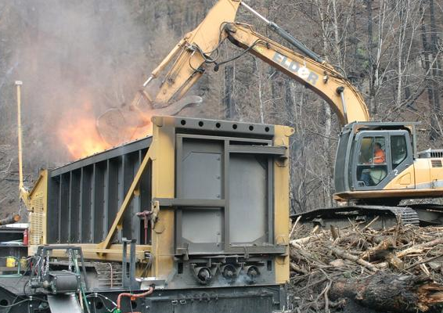
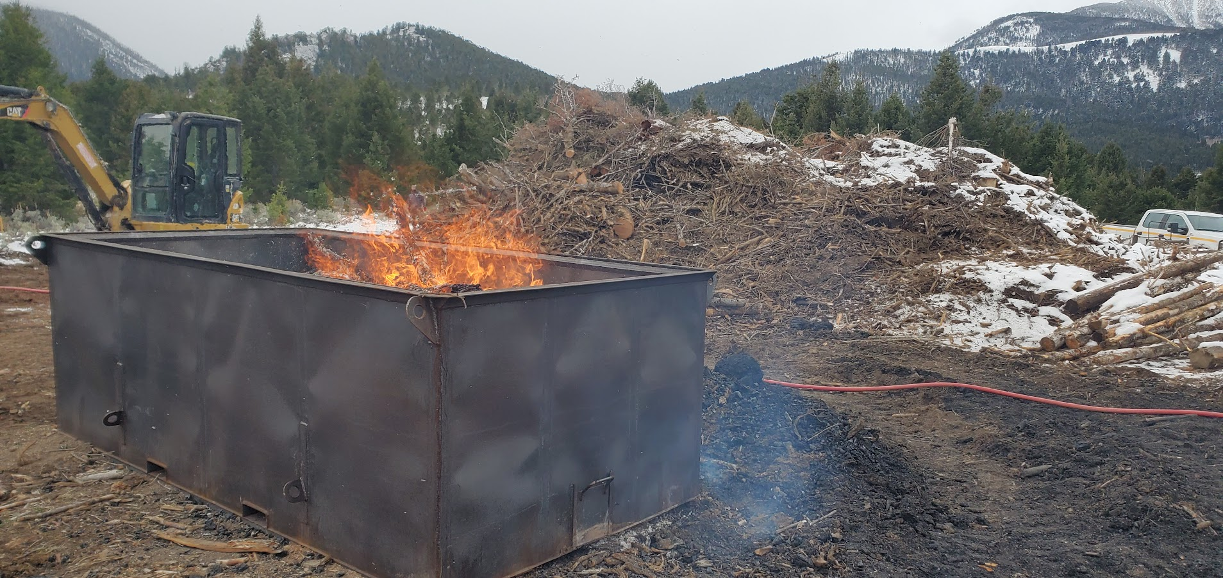
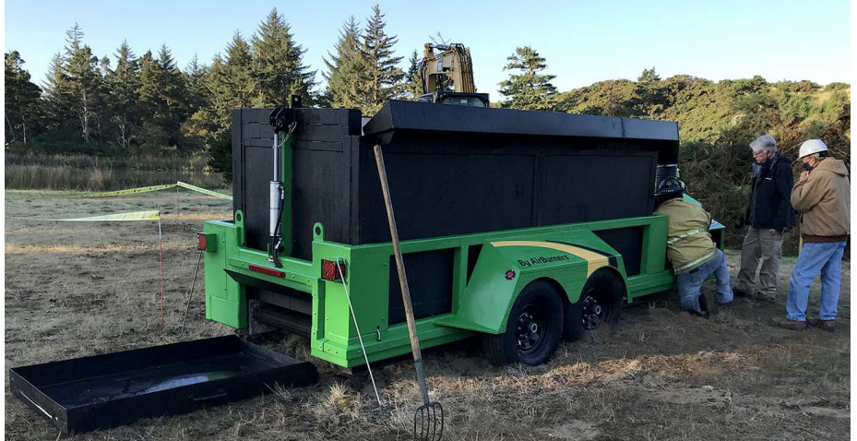
Conservation (hand-built) burn piles
Protect the ground and restrict airflow
Let’s Make Biochar!
Purpose built slash piles (CBPs)
Kilns of different sizes
Air curtain burners (ACBs)
Ring of Fire Kiln
Carbonator by TigerCat©
Big Box Kiln
AirBurnersCharboss by ©
Notes:
Slide content courtesy of D. Pierson, USFS.
One option is to just build slash piles that create biochar. The quality of the biochar is relatively low and the material is chunky, but it does sequester C, large burn scars can be avoided if the piles are build with large logs on the bottom, and air pollution can be minimized if the piles are burned to create a flame cap on top

Slide 21
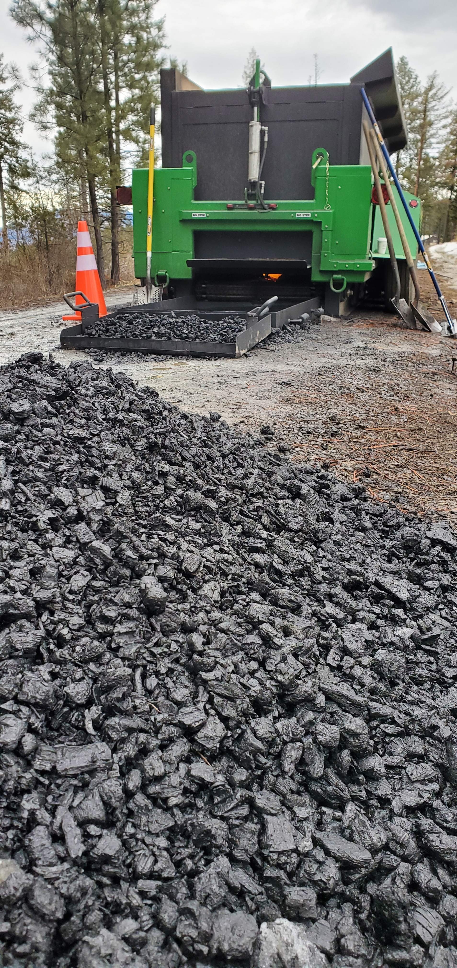
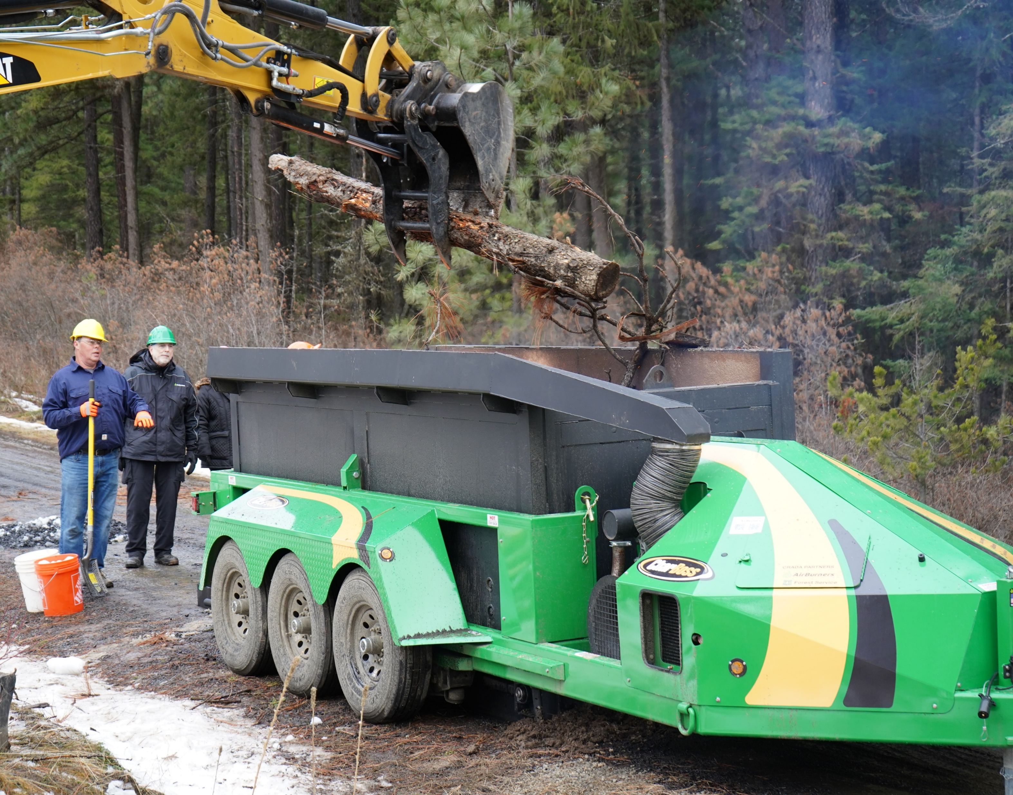
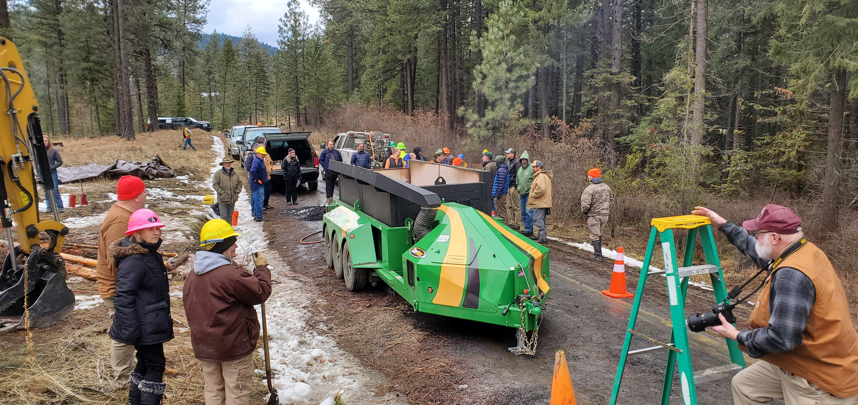
The Charboss
Mobile pyrolysis unit
Processes ~1 ton of slash per hour
Returns 10-20% as biochar
Sequesters ~30% of the carbon
Demo @ U-Idaho EF
Notes:
This is a commercial biochar kiln that the Forest Service has been using in a lot of research and demonstrations.

Slide 22
Biochar potential on private nonindustrial forestland
  Potential soil health and environmental benefits of biochar:
    Improved water and nutrient holding capacity, liming effects
    Potential for improving soil ecology
    Long term SOC improvements
    Fuelwood/ debris removal
    Reduced CO₂ emissions
  Constraints:
    Biochar production equipment cost
    Suitable target site or market nearby?
    Other costs:
      Equipment to move char
      Time, labor
      Water requirements
Remsberg, SARE

Slide 23
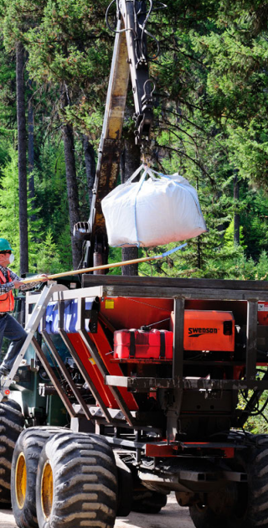
Some NRCS Incentives may create affordable options for Biochar use.
Biochar Affordability
Production:
  CPS 384-- Woody Residue Treatment
    Intended to remove woody slash and debris from stands.
    Purposes:
      Reduce hazardous fuels
      Protect and maintain air quality by reducing the risk of wildfire,\
      Improve soil organic matter.
    Enhancement: E384A Biochar production from woody residue
      Provides financial assistance to a producer to take the debris and produce biochar.
Application:
  CPS 336—Soil Carbon Amendment
  CPS 484--Mulching

Slide 24
Summary
Biochar is a very stable carbon material that has high porosity, low bulk density, and high nutrient and water holding capacity. Specific characteristics vary widely according to feedstock and pyrolysis method.
Biochar can be an effective amendment to improve soil health in soils with low pH, organic matter, and water holding capacity.
There is an abundant supply of woody feedstock available in slash piles and storm damaged areas.
Cochrane, NRCS
Notes:
Photo: Kristin Trippe, USDA-ARS

Slide 25
Summary
There are several methods of producing biochar with a wide range of technology and cost, but they all require high labor and water inputs.
Many southeastern soils could benefit from biochar, but site and other factors need to be considered.
Economic, labor, logistics, and market constraints limit the potential for biochar production on nonindustrial private forest land.
Cochrane, NRCS
Notes:
Photo: Kristin Trippe, USDA-ARS

Slide 26
Thank you!
For more information on Managing Soil Health,
visit us here:
https://www.nrcs.usda.gov/conservation-basics/natural-resource-concerns/soils/soil-health
USDA is an equal opportunity provider, employer, and lender.
Meeh, NRCS

